Slide 1
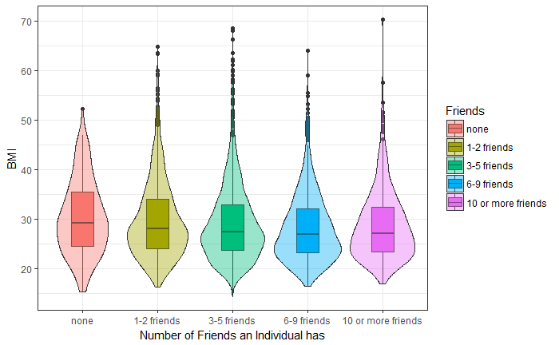
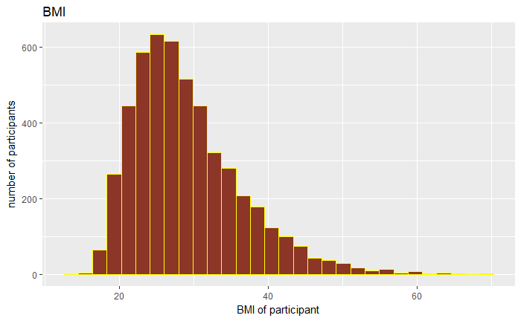
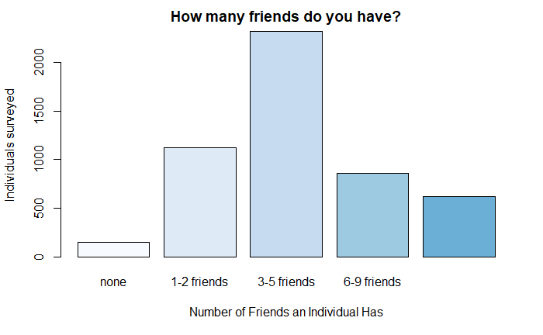
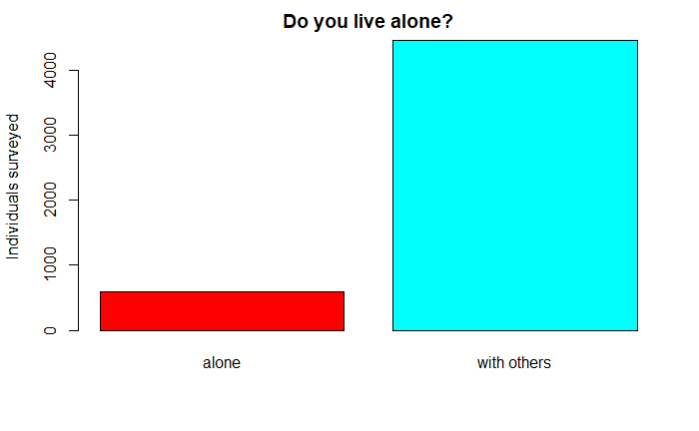
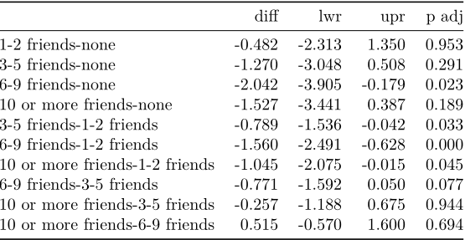
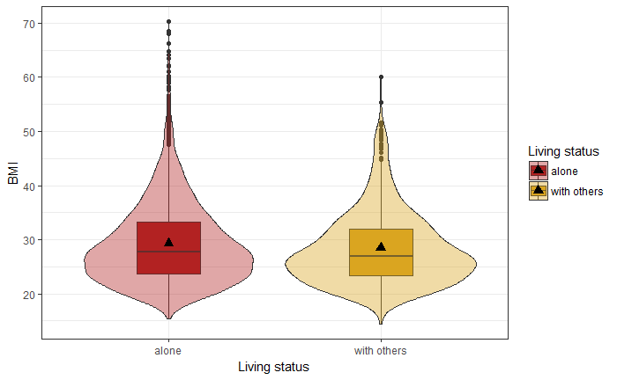

The Effects of Social Isolation on BMI
Drew Gilberti
California State University, Chico.
Friend’s Influence on BMI
Univariates
Social isolation and loneliness are increasingly common problem that are thought to directly impact an individual’s well-being. Having at least a few close friends is important for self-esteem and the reduction of depressive behavior. Friends are especially important to adolescent children, who will become withdrawn and unhappy. Social isolation, a state where an individual has a complete lack of contact with other humans for an extended amount of time, has been linked to an increase in cardiovascular disease, blood pressure, increased inflammatory response to stress, and even mortality.
A significant relationship was found between BMI and the number of friends a person has. At the most extreme, people with 10 or more friends had 1.527 less BMI when capered to those with no friends.
BMI
A continues measurement of someone's BMI.
Number of friends
A categorical variable to measure the number of friends an individual has.
The Question
Live alone
A binary measurement of if someone lives alone or with others.
Do individuals with fewer friends suffer from increased BMI?
Do those that live alone suffer from increased BMI?
Methods
Discussion
Data was obtained from the National Longitudinal Study of Adolescent to Adult Health. The study was designed to explore the developmental and health trajectories of adolescence as they mature into adulthood. Wave IV dataset is the fourth in-home interview. The participants consisted of 6504 participants, ages 24 to 32, 52% women, and a carried ethnicity.
The number of friends a person has and their BMI significantly associated. In addition, whether a person lives alone or with others is significantly associated with BMI. This is consistent with other studies that have explored the consequences of social isolation.
Impact on BMI From Living Alone
People who live alone are, on average, have a higher 0.81(.207, 1.41) BMI compared to people who live with others.
Implication
Friends play a central role in the health in the modern world. The average person has few friends than those that lived 100 years ago. A lack of social connectedness may lead to a mental health disorders or bully-victimization (Braddock et al., 2015), so social skills or relationship based treatments are especially important for those who struggle to find friends.
References
Braddock, B. A., Twyman, K. A., Garrity, M. R., Wang, T., Neary, M. K., Ezzelgot, J., & Heithaus, J. L. (2015). A Few Close Friends. Clinical Pediatrics, 54(12), 1192–1199. https://doi.org/10.1177/0009922815570619 Chow, C. M., & Buhrmester, D. (2011). Interdependent patterns of coping and support among close friends. Journal of Social and Personal Relationships, 28(5), 684–705. https://doi.org/10.1177/0265407510386134 Schnittker, J. (2007). Look (Closely) at All the Lonely People. Journal of Aging and Health, 19(4), 659–682. https://doi.org/10.1177/0898264307301178 Wilcox, K., & Stephen, A. T. (2013). Are Close Friends the Enemy? Online Social Networks, Self-Esteem, and Self-Control. Journal of Consumer Research, 40(1), 90–103. https://doi.org/10.1086/668794

